Slide 1

Advanced Docker Best Practices
Kostas Kalevras, DevOps Engineer, GUNet

Slide 2

Agenda
Part 1
Business as Usual
Problems
The case for Docker
Part 2
Docker best practices

Slide 3

Business as Usual
1 VM per service and institutions
Service Stack
Debian OS (JeOS)
Debian packages
Custom binaries
Configuration files
Static/dynamic web pages
Installation - Management
Manually
Scripts

Slide 4
Problems
Imperative
Define how to do the task, not where you want to go
Hard to automate
Hard to scale
Development and Operations are very hard to split
Service Management
VM package management
Service binaries
Service configuration

Slide 5
The case for Docker 1/3
Lightweight self-contained, isolated mini “VMs”
Well-defined images (Dockerfile commands). Basically, a Service as Configuration
Image stacks (every image extends an existing image)
Image registries
Version tagging (mariadb:latest, mariadb:10.6)
Known image size
UnionFS (shared layers)

Slide 6
The case for Docker 2/3
Layered Stack
Immutable image (service binaries and base configuration)
Env variables for per-container configuration
Volumes to hold actual data ( host filesystem)
Low-cost container creation/destruction
Container – VM decoupling – Thin Docker Host
Defined resource limits (CPU, memory, logs)
Plugin Interface

Slide 7
The case for Docker 3/3
Custom images and Docker compose stacks
GitOps
Remote Management (Docker contexts)
Declarative
Define the end state
Easy to automate
Relatively easy to scale

Slide 8

Part 2
Docker best practices

Slide 9
Distributions – Image slim versions
Use the distribution you know
ie Debian, not Alpine
You gain in size but use what you already know
Try using slim versions and add any packages you need
Bullseye-slim vs bullseye (80MB < 125MB)
Python slim vs vanilla python (130MB < 920MB)
Node slim vs vanilla node (190MB < 910MB)

Slide 10
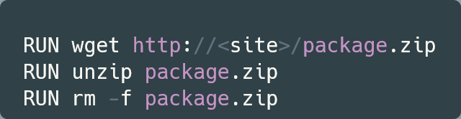
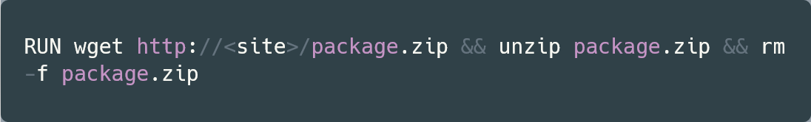
Layers
RUN wget http://<site>/package.zip RUN unzip package.zip RUN rm -f package.zip
RUN wget http://<site>/package.zip RUN unzip package.zip RUN rm -f package.zip
Each RUN creates a new layer in UnionFS
You cannot delete previous layers
The rm below will have no effect
Run all commands in one layer:
Start with the most basic and less changed layers first (Build caching, shared layers)
Install packages
Code
Configuration files
When installing packages always clean-up in the same RUN layer

Slide 11
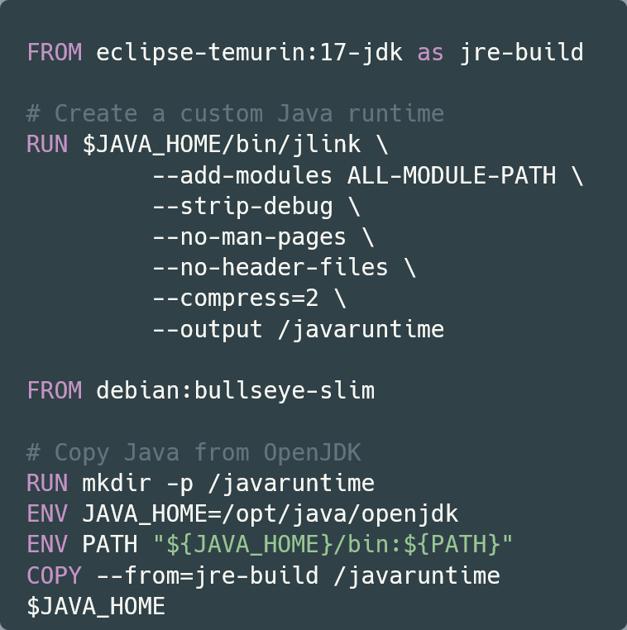
Multi-stage builds
RUN wget http://<site>/package.zip RUN unzip package.zip RUN rm -f package.zip
RUN wget http://<site>/package.zip RUN unzip package.zip RUN rm -f package.zip
Don’t use large images or install packages only for building
Use multi-stage building: A separate container is used as builder
Example: Use eclipse JDK to build JRE while the base image is debian:bullseye-slim

Slide 12
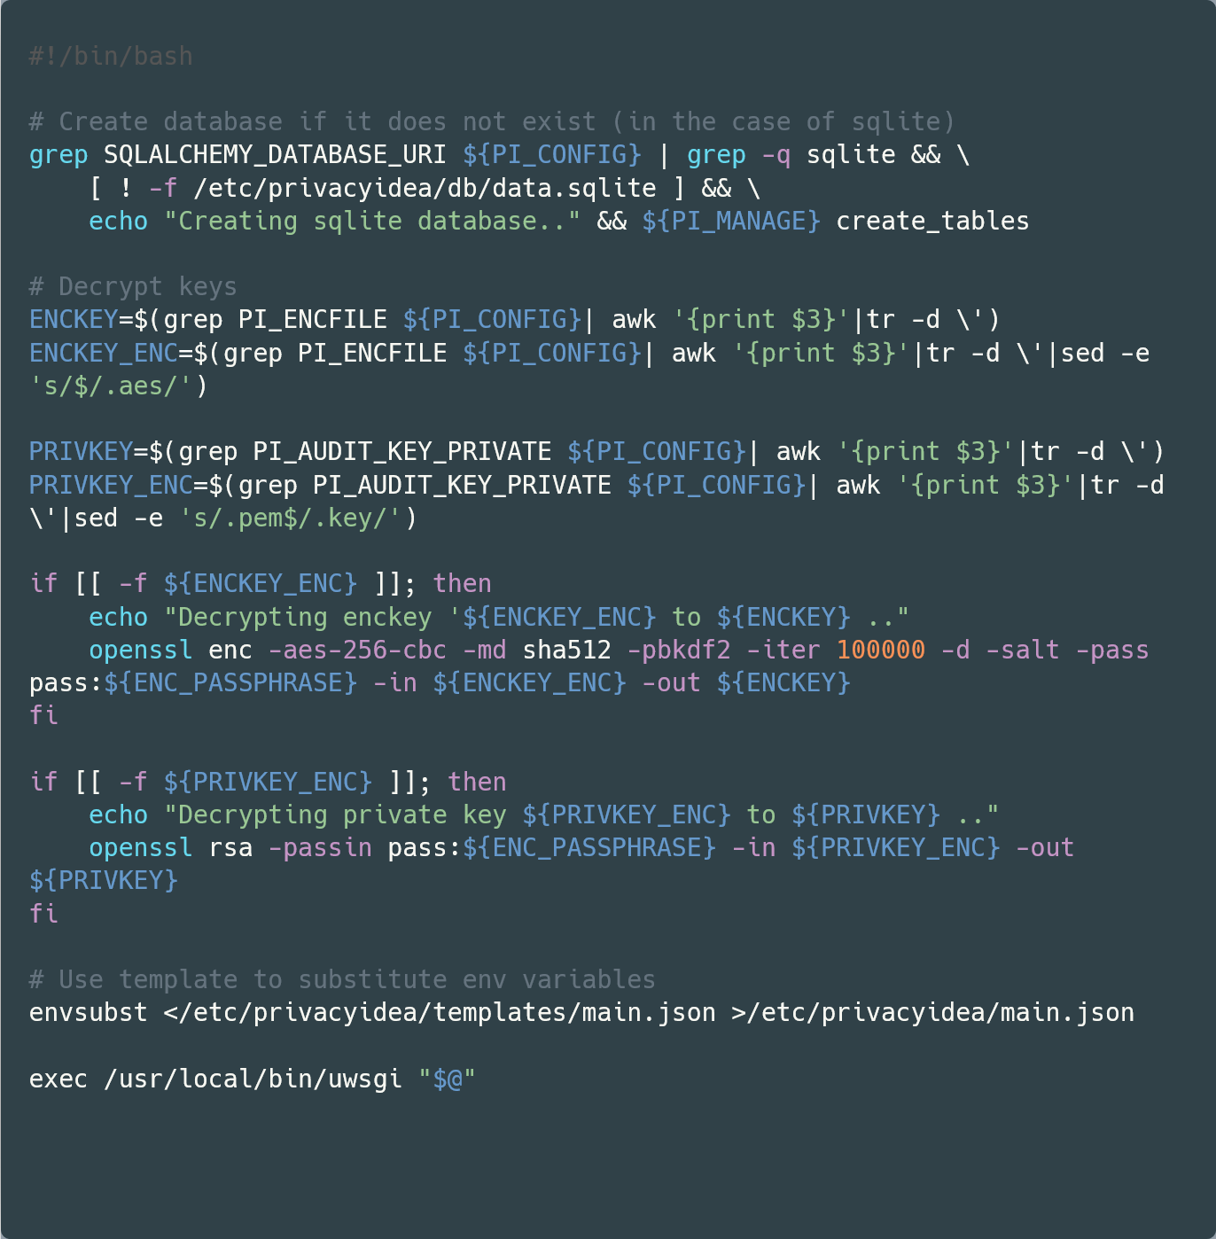
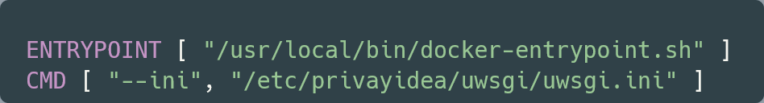
Docker entry point
RUN wget http://<site>/package.zip RUN unzip package.zip RUN rm -f package.zip
RUN wget http://<site>/package.zip RUN unzip package.zip RUN rm -f package.zip
Create a Docker entrypoint to run various tasks on startup and finally call your application using exec
In the Dockerfile you set the ENTRYPOINT to point to your entrypoint script and pass arguments using the CMD instruction
Benefits
Signals go to your application, not the shell
Setup things on first run
Substitute environment vars in configuration files using envsubst
Decrypt keys using a passphrase passed as env var

Slide 13
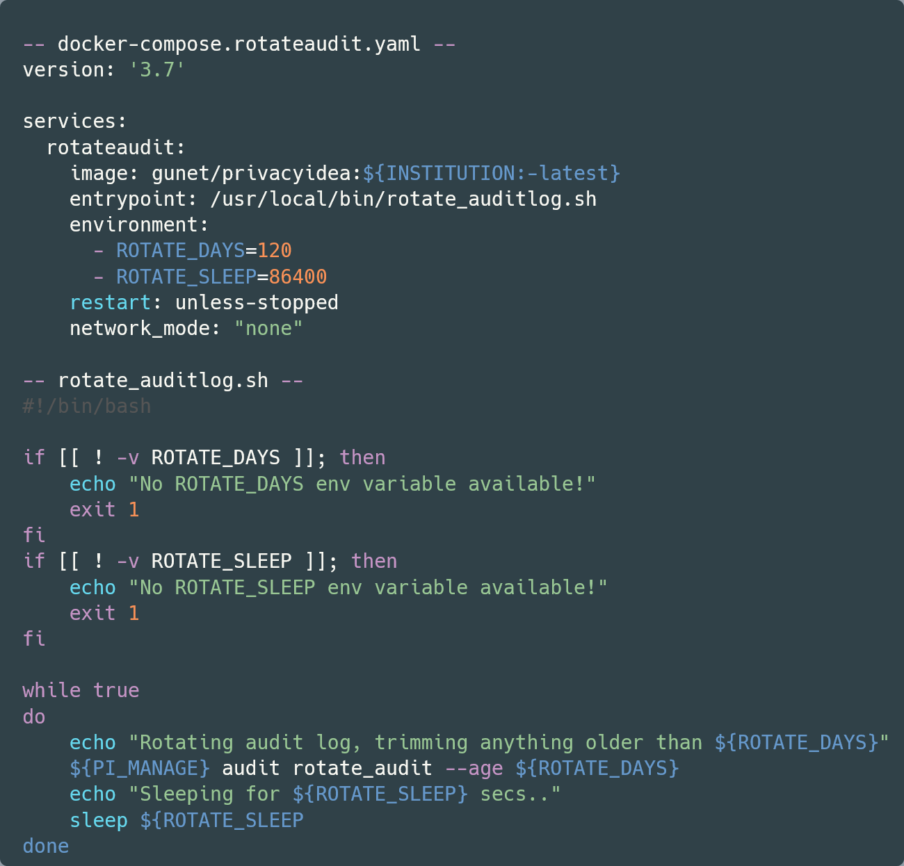
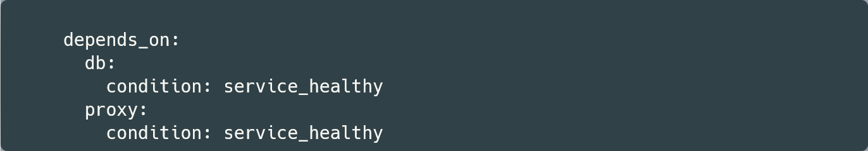
Dependency stack
RUN wget http://<site>/package.zip RUN unzip package.zip RUN rm -f package.zip
RUN wget http://<site>/package.zip RUN unzip package.zip RUN rm -f package.zip
In Docker Compose we can setup a dependency stack
A service only starts if the dependencies have started
We can add a healthy requirement
Cron Jobs
Docker does not include Cron jobs
Kubernetes does
We can approximate with a script that sleeps between runs

Slide 14
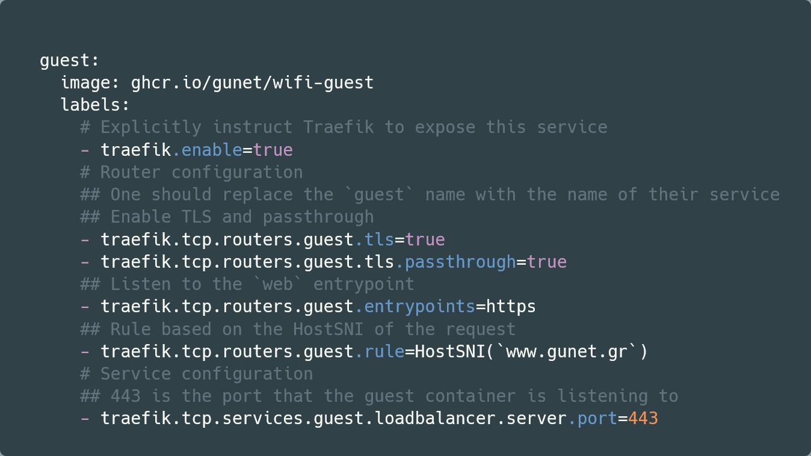
Dynamic Routing
RUN wget http://<site>/package.zip RUN unzip package.zip RUN rm -f package.zip
RUN wget http://<site>/package.zip RUN unzip package.zip RUN rm -f package.zip
Docker Compose stack with multiple services
Traefik dynamic routing
Configuration using Docker Compose labels
Routing
HTTP (Host header)
HTTPS (SNI)
Client-IP
HTTP headers (X-Forwarded-For)
PROXY2 protocol (SSL)
Apache supports both
Middleware
BasicAuth
IP Whitelisting

Slide 15
GitHub integration
RUN wget http://<site>/package.zip RUN unzip package.zip RUN rm -f package.zip
RUN wget http://<site>/package.zip RUN unzip package.zip RUN rm -f package.zip
GitHub Container Registry (GHCR)
Integrate repo with Docker images
Inherit access rights
Private repo has private packages
Only users with access to repo can access packages
Easy integration in GitHub Actions

Slide 16
GitHub Actions
RUN wget http://<site>/package.zip RUN unzip package.zip RUN rm -f package.zip
RUN wget http://<site>/package.zip RUN unzip package.zip RUN rm -f package.zip
Build images using GitHub actions
Build on
Push
Pull Request
Manual invocation
Common restrictions
Branch
Folders/files
Integrated with GHCR
Workflow stacks
Can be used for
Tests
Linting

Slide 17
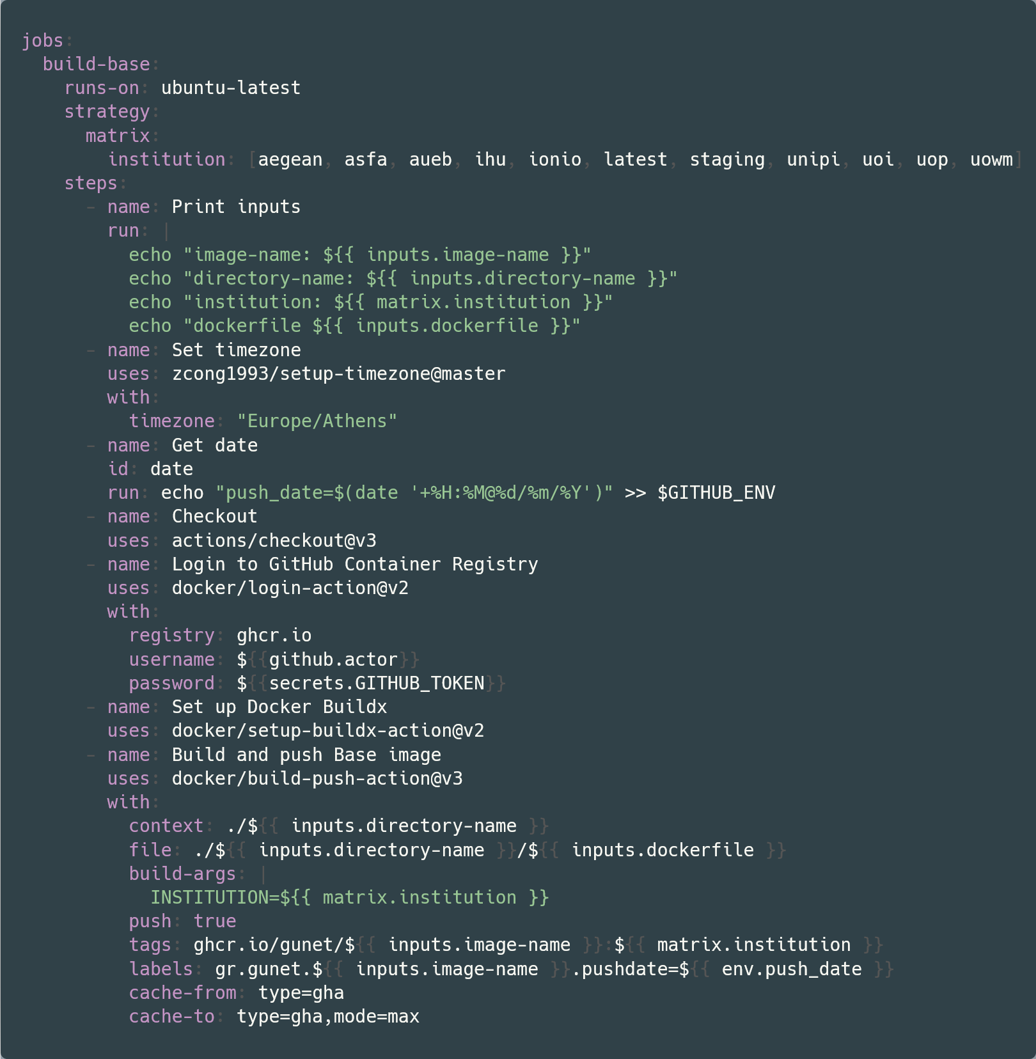
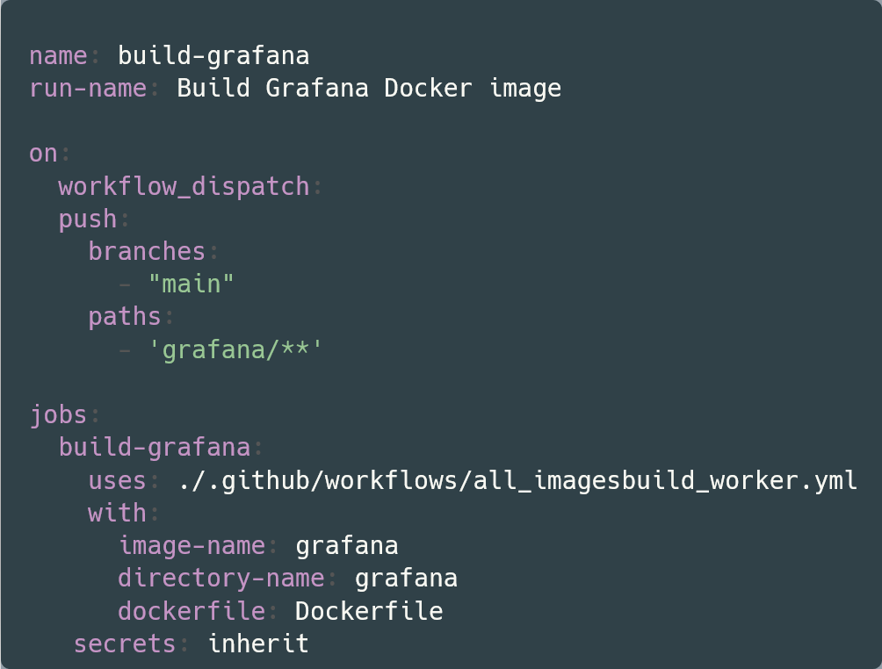
GitHub Actions Example
RUN wget http://<site>/package.zip RUN unzip package.zip RUN rm -f package.zip
RUN wget http://<site>/package.zip RUN unzip package.zip RUN rm -f package.zip

Slide 18
Thank you
Comments - Questions

